Slide 1


Minimising Dilapidations Settlements

Slide 2


Slide 3
Commercial Property Market
Pandemic accelerated many pre-existing trends, as well as triggering new shifts
Bricks and mortar retail was already in significant flux, and industrial/logistics investment gem
Many offices were already past their sell by date and Covid has accelerated the ‘flight to quality’ and in many locations, greater value can now be extracted by repurposing/redeveloping (often as resi)
Since 2007 recession, leases of commercial & leisure properties have shortened to commonly 5-10 years, often with tenant breaks at years 3-5
This perfect storm of mounting obsolescence, evolving demand parameters and shorter leases/breaks, is making for an ever increasing volume of either lease renewals or, terminal dilapidations, negotiations

Slide 4
Dilapidations Fundamentals
Section 18 for repairs, and common law for decorations & reinstatement, cap damages at the lower of Cost of Works, or impact on Value (of “the reversion”)
The BS identifies breaches & prices remedies as the Expert in that field. It is not for the BS to either argue certain breaches Not Value Affective (NVA), or to advise you if a DV is necessary
In practice, impact of dilaps on Value is all but always less. Usually far less.
Because:
  The specialist Valuer will judge and persuasively argue, many breaches will be overridden (superseded) by reasonably assumed hypothetical purchaser’s works to repurpose, modernise etc; and
  Whilst breaches for the BS to identify and price, not all affect Value (age, character and locality)

Slide 5
Dilapidations Fundamentals
Commonly the claimed works are not done. Paragraph 9.4 of the Dilapidations Protocol obligates Landlords to produce their own DV in these cases.
Don’t settle without requiring one, then robustly rebutting it.
It is a Valuer, not a BS, who advises if a Landlord’s reletting with an SoC and/or extended RFP really supports the Landlord’s dilapidations claim?!? (Similarly consider whether SoC lends you much real protection. See EG article)
Without a DV, it follows that settlement usually ends up about half way between opposing building surveyors opening shots.
With a DV, settlement ends up at worst near, at best well below, your Building Surveyor’s minimum costs assessment .
The following table of settlements for JD illustrates..

Slide 6
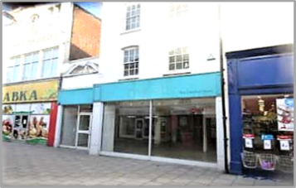
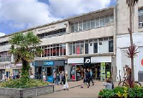
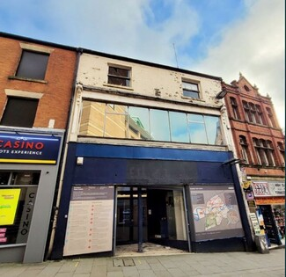
Address | Landlord’s Claim | Tenant’s Response by appointed building surveyors | Radius s18/DV | Settlement Sum | Comment
HEREFORD 12/14 Eign Gate | £101,000 | £72,000 | £42,000 | £55,000 | Settled at 24% lower than the Response/costed assessment by Tenant’s appointed building surveyors.
PLYMOUTH 52 New George Street | £306,000 | £101,000 | £95,000 | £75,000 | Settled at 25% of the Landlord’s claim (and again, lower than the Response assessment by the Tenant’s appointed building surveyors).
ROCHDALE 38 Yorkshire Street | £154,000 | £23,000 | £15,000- £20,000 | £23,000 | The Radius DV compelled settlement at bang on the Tenant’s Response sum, not the usual middle ground between opposing building surveyors.

Slide 7
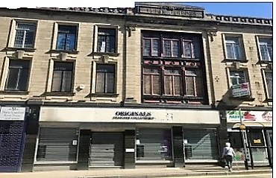
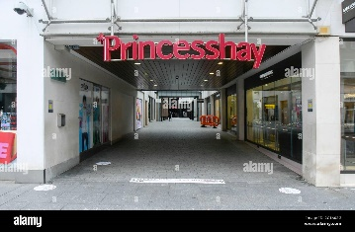
Address | Landlord’s Claim | Tenant’s Response by appointed building surveyors | Radius s18/DV | Settlement Sum | Comment
BURNLEY 123-125 St James’ Street | £100,000 | £44,000 | £22,500 | £28,000 | Settled at 36% lower than the assessment/Response by the Tenant’s appointed building surveyors.
EXETER 22 Princesshay Shopping Centre | £49,000 | £28,000 | £2,500-£5,000 | £10,000 | Settled at 64% lower than assessment of the Tenant’s appointed building surveyors.

Slide 8
Dilapidations Fundamentals
Settlements achieved at notably less than the Tenant’s appointed Building Surveyor’s assessment.Without our DV input,settlements would otherwise have been negotiated at a sum in the range between opposing Building Surveyors

Slide 9
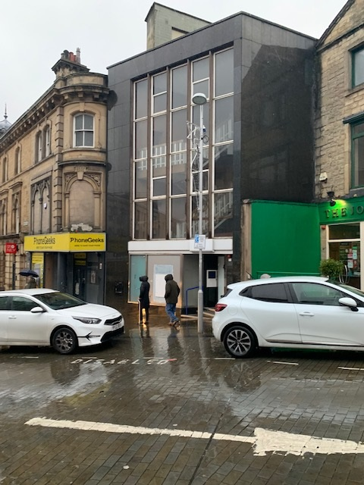
BARNSLEY
LL’s Common Law Claim - £743,000
T’s B.S RESPONSE - c.£300,000
DV - £70,000
RESULT - £100,000 (inclusive of costs)
  Thorough research of the local retail market concluded a likely value in repair of, say, £223,000. Values had fallen significantly in post Covid era
  Therefore spending anywhere near the sums sought by the Landlord would not add anywhere near the same level to value
  Property ultimately sold for £150,000 in the open market out of repair
  Landlord produced their own DV suggesting a value in repair of £360,000 – thus a Diminution of £210,000
  Our knowledge of Zone A values, appropriate upper floor rates and yields assisted in dismissing the Landlord’s Diminution

Slide 10
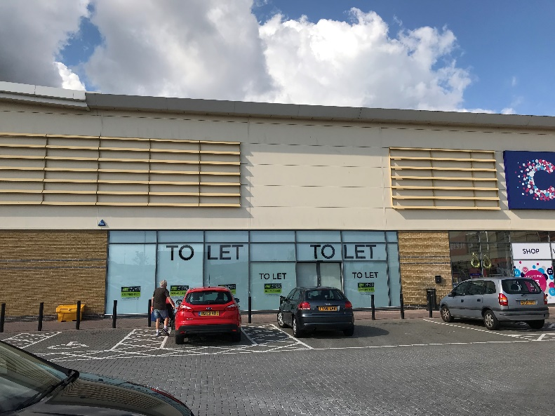
ISLE OF SHEPPEY
LL’s Common Law Claim - £226,477
T’s B.S RESPONSE - £45,949
RESULT - £12,875 (inclusive of Radius fee)
Our report provided ammunition to illustrate that very few, if any, of the works agreed between building surveyors would impact lettabillity:
    Internal Decorations – to be superseded
    Strip out partitioning – to be retained as it creates useful back of house areas, especially for a short/medium term letting

Slide 11
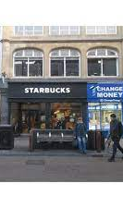
OXFORD
LL’s CLAIM - £300,000
T B.S RESPONSE - £165,000
DV - £50,000
RESULT - £50,000
NVA Works included:
  Internal Decorations
  Works to upper floor ancillary – to be converted
Simultaneously agreed sub lease Dilapidations

Slide 12
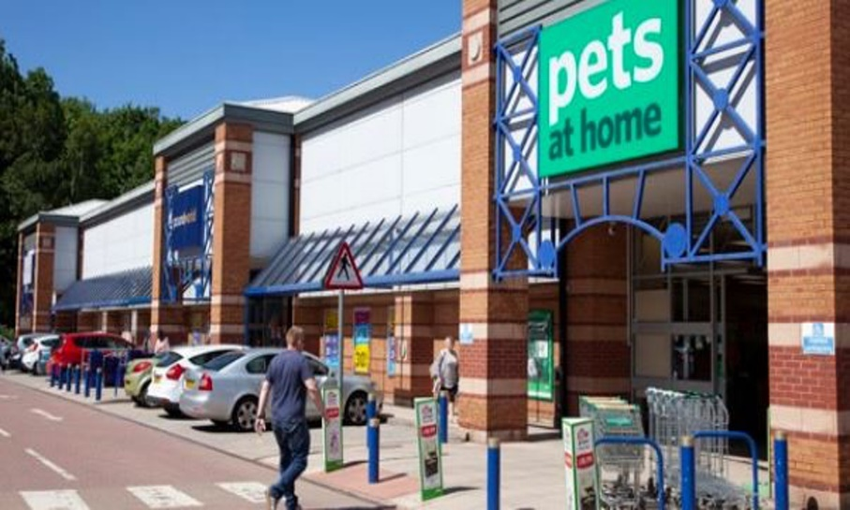
SHEFFIELD
LL’S CLAIM - £130,000 (as per works undertaken) – agreed between B.S
DV - £46,165
Part of a retail park with significant voids
Supply outweighed demand
Analysis of local comps illustrated this was market led
Not all works will be value affective:
  Paint internal walls – will be superseded
  Remove security shutter – retained
  Clean soiled cladding – will become dirty during void
Settlement £70,000

Slide 13
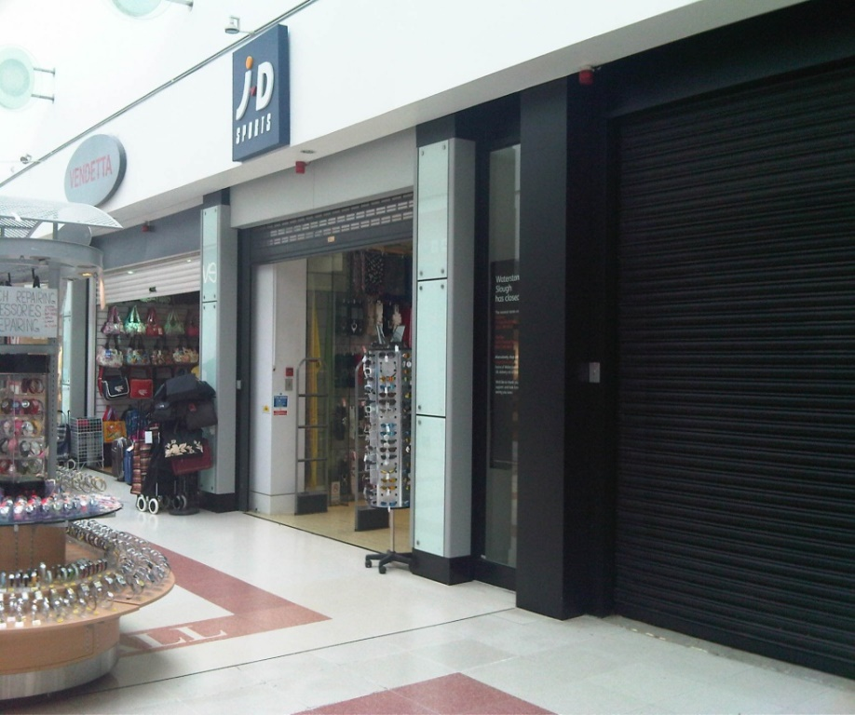
SLOUGH
LANDLORD’S CLAIM - £52,059.27
DV - £Nil
Example of excess supply of retail units relative to demand within Shopping Centre
Half of units within same mall vacant
SETTLEMENT - nominal

Slide 14
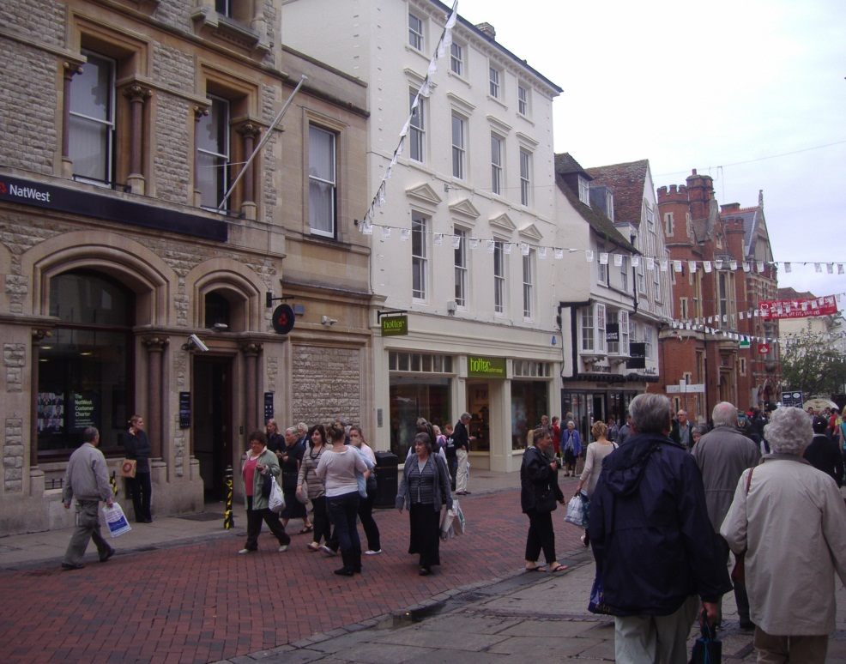
CANTERBURY
Landlord undertook the works and relet. Claiming ‘cost of works’ as a measure of their ‘loss’
Cost of Works - £150,000
DV for T - £70,000.
Had done considerable decorative works to upper parts – not value affective
In fact, the rent review clause in the new lease specifically directed that nil value would be applied to the upper floors at review
Settlement - £75,000

Slide 15
The Fear
Sooner or later, Landlords ‘threaten’ to issue, and pressure mounts to cave in.
Service of a Part 36 offer.
But fewer than 1% make Trial.
Now all but compulsory to mediate [Churchill v Merthyr Tydfil B.C 2023].
At which > 90% settle.
Costs £15k-£20k.
Openly offer to mediate, naming three ‘suitable’ mediators, and reminding of costs sanction for refusing/ignoring. Take control!
Also fear of fees anyway. But is avoiding a DV really a saving?

Slide 16


















