Slide 1


Minimising Dilapidations Settlements

Slide 2


Slide 3
Post Pandemic Commercial Property Market
Pandemic has accelerated many pre-existing trends, as well as triggering new shifts
Bricks and mortar retail was already in significant flux, and industrial/logistics investment gem
Many offices were already past their sell by date and Covid has accelerated the ‘flight to quality’ and in many locations, greater value can now be extracted by repurposing/redeveloping (often as resi)
Since 2007 recession, leases of commercial & leisure properties have shortened to commonly 5-10 years, often with tenant breaks at years 3-5
This perfect storm of mounting obsolescence, evolving demand parameters and shorter leases/breaks, is making for an ever increasing volume of either lease renewals or, terminal dilapidations, negotiations

Slide 4
Dilapidations Fundamentals
Section 18 for repairs, and common law for decorations & reinstatement, cap damages at the lower of Cost of Works, or impact on Value (of “the reversion”)
The BS identifies breaches & prices remedies as the Expert in that field. It is not for the BS to either argue certain breaches Not Value Affective (NVA), or to advise you if a DV is necessary
In practice, impact of dilaps on Value is all but always less. Usually far less.
Because:
  The specialist Valuer will judge and persuasively argue, many breaches will be overridden (superseded) by reasonably assumed hypothetical purchaser’s works to repurpose, modernise etc; and
  Whilst breaches for the BS to identify and price, not all affect Value (age, character and locality)

Slide 5
Dilapidations Fundamentals
Commonly the claimed works are not done. Paragraph 9.4 of the Dilapidations Protocol obligates Landlords to produce their own DV in these cases.
Don’t settle without requiring one, then robustly rebutting it.
It is a Valuer, not a BS, who advises if a Landlord’s reletting with an SoC and/or extended RFP really supports the Landlord’s dilapidations claim?!?
Without a DV, it follows that settlement usually ends up about half way between opposing building surveyors opening shots.
With a DV, settlement ends up at worse near, at best well below, your Building Surveyors minimum costs assessment

Slide 6
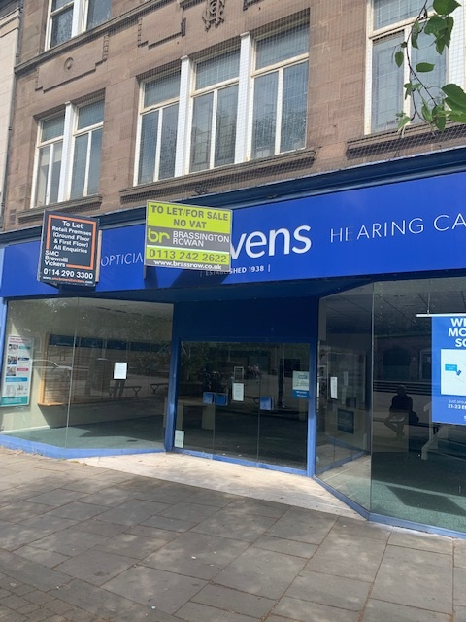
ROTHERHAM
LL’s Common Law Claim - £100,000
T’s B.S RESPONSE - £50,000
DV - £20,000
RESULT - £20,000
Much of the claim related to the upper floors including:
    Strip out of partitions
    Redecoration
    Replace floor coverings
The upper floors will attract little value, regardless of condition – therefore these works unlikely to be ‘value affective’

Slide 7
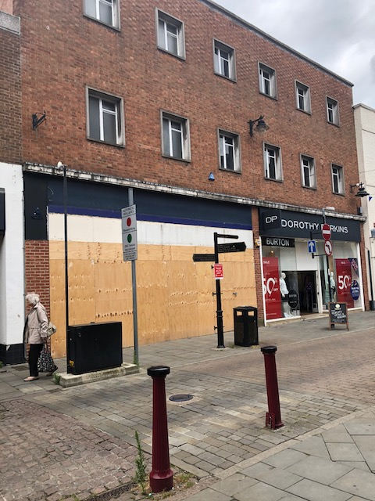
NEWARK
COMMON LAW AGREED BETWEEN B.S - £100,000
GF of property relet at lease expiry to Bodycare – upper floors retained by Landlord
DV - £50,000 – mainly relating to roof works that would have to be undertaken as Landlord responsibility
Two upper floors unlikely to be relet regardless of condition – no market
RESULT - £67,500

Slide 8

OXFORD
LL’s CLAIM - £300,000
T B.S RESPONSE - £165,000
DV - £50,000
RESULT - £50,000
NVA Works included:
  Internal Decorations
  Works to upper floor ancillary – to be converted
Simultaneously agreed sub lease Dilapidations

Slide 9
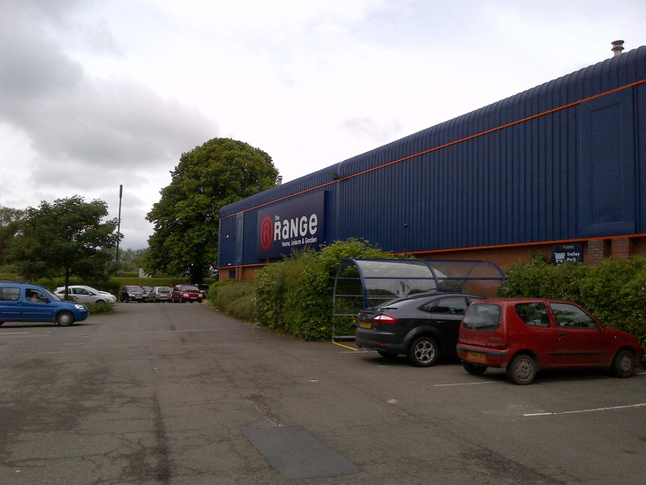
HEREFORD
LL’S CLAIM - £235,000
DV - £25,000
Property relet to The Range
Deal included £168k incentive – LL claimed this was in lieu of works
Analysis of local comps illustrated this was market led
Settlement £50,000

Slide 10
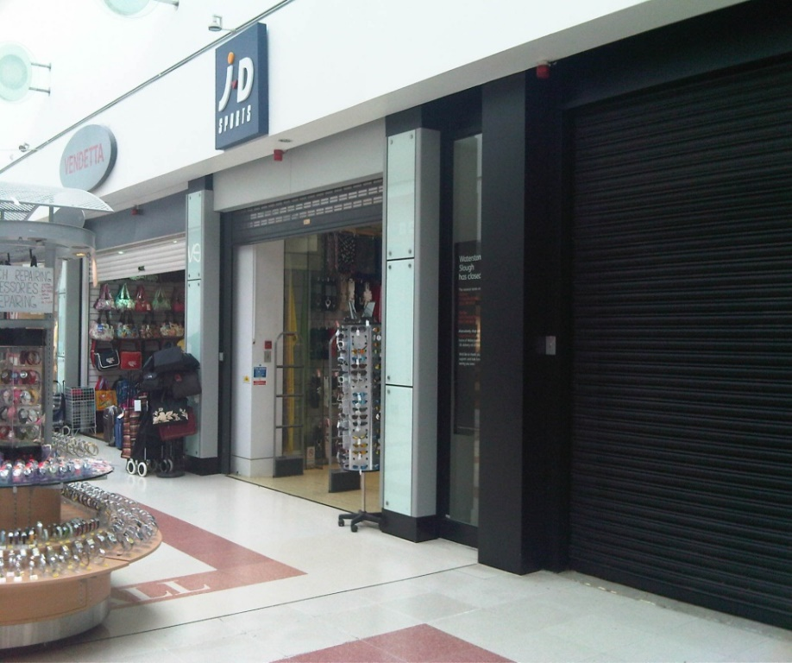
SLOUGH
LANDLORD’S CLAIM - £52,059.27
DV - £Nil
Example of excess supply of retail units relative to demand within Shopping Centre
Half of units within same mall vacant
SETTLEMENT - nominal

Slide 11

CANTERBURY
Landlord undertook the works and relet. Claiming ‘cost of works’ as a measure of their ‘loss’
Cost of Works - £150,000
DV for T - £70,000.
Had done considerable decorative works to upper parts – not value affective
In fact, the rent review clause in the new lease specifically directed that nil value would be applied to the upper floors at review
Settlement - £75,000

Slide 12



















Slide 13
Top Tips
Don’t get a DV
But see the case studies on both the Radius and Dilapsolutions websites
Commonly, settlements end up at between the Tenant B.S’s initial (‘try on’) response, and about 50% of it
In Shopping Centres, at zero
Don’t buckle under ‘threats’, fewer than 1% make trial, and over 80% settle through mediation
The classic oxymoron

